Slide 1
Thermal Loop Data Graphs

Slide 2
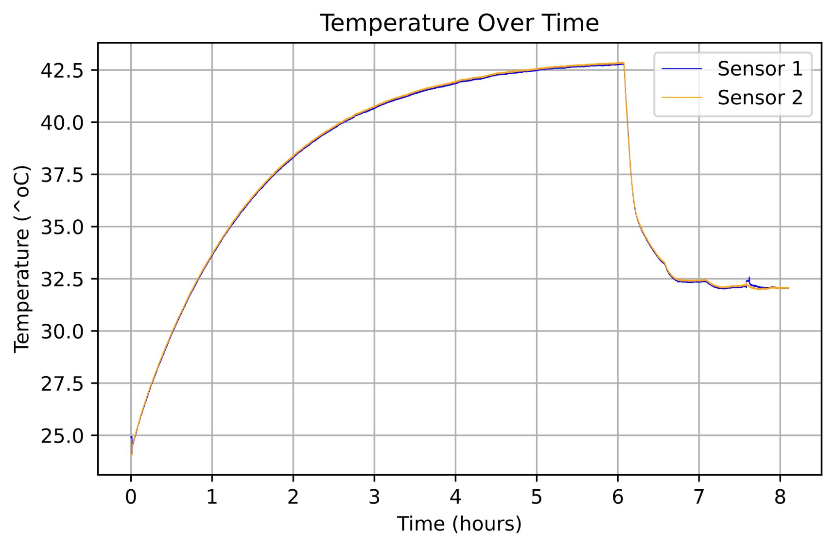
Test #1: Pump Heat up (vo)
Middle valve open
Upper valve open
Heat exchange increments of 0.5 gal/min every 30 mins starting at hour 6
Raw Data File name
PumpHeat_HeatExhanger.flow.vo
PDF name- Full_PumpHeat(HeatExchange.flow.vo)

Slide 3
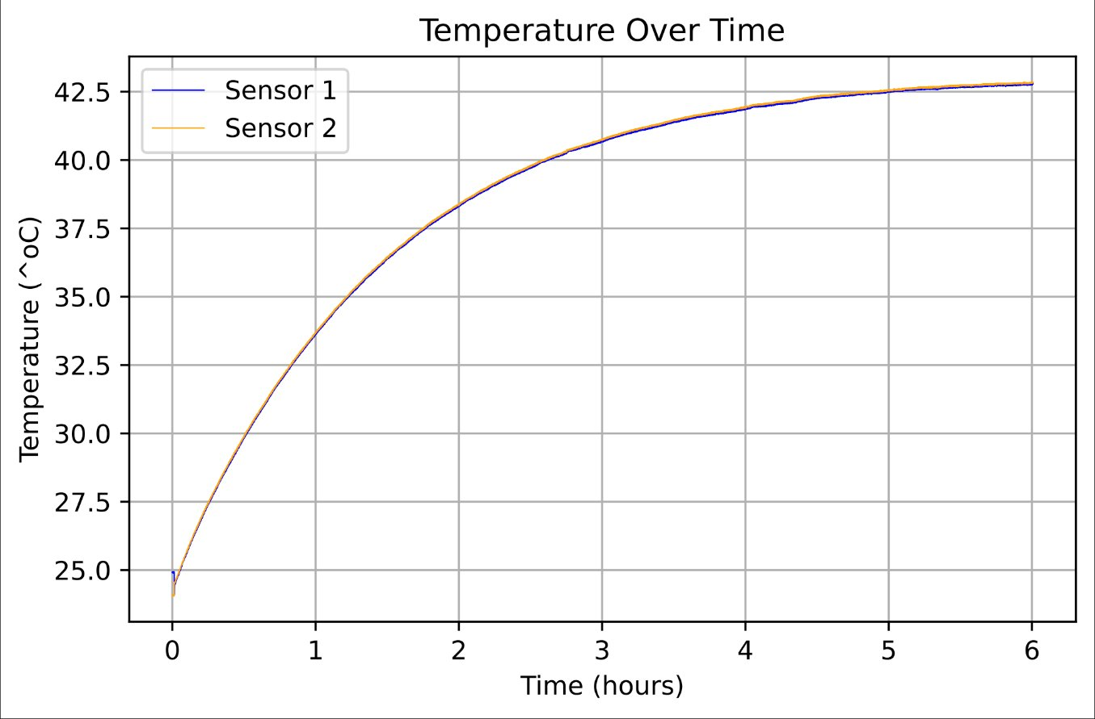
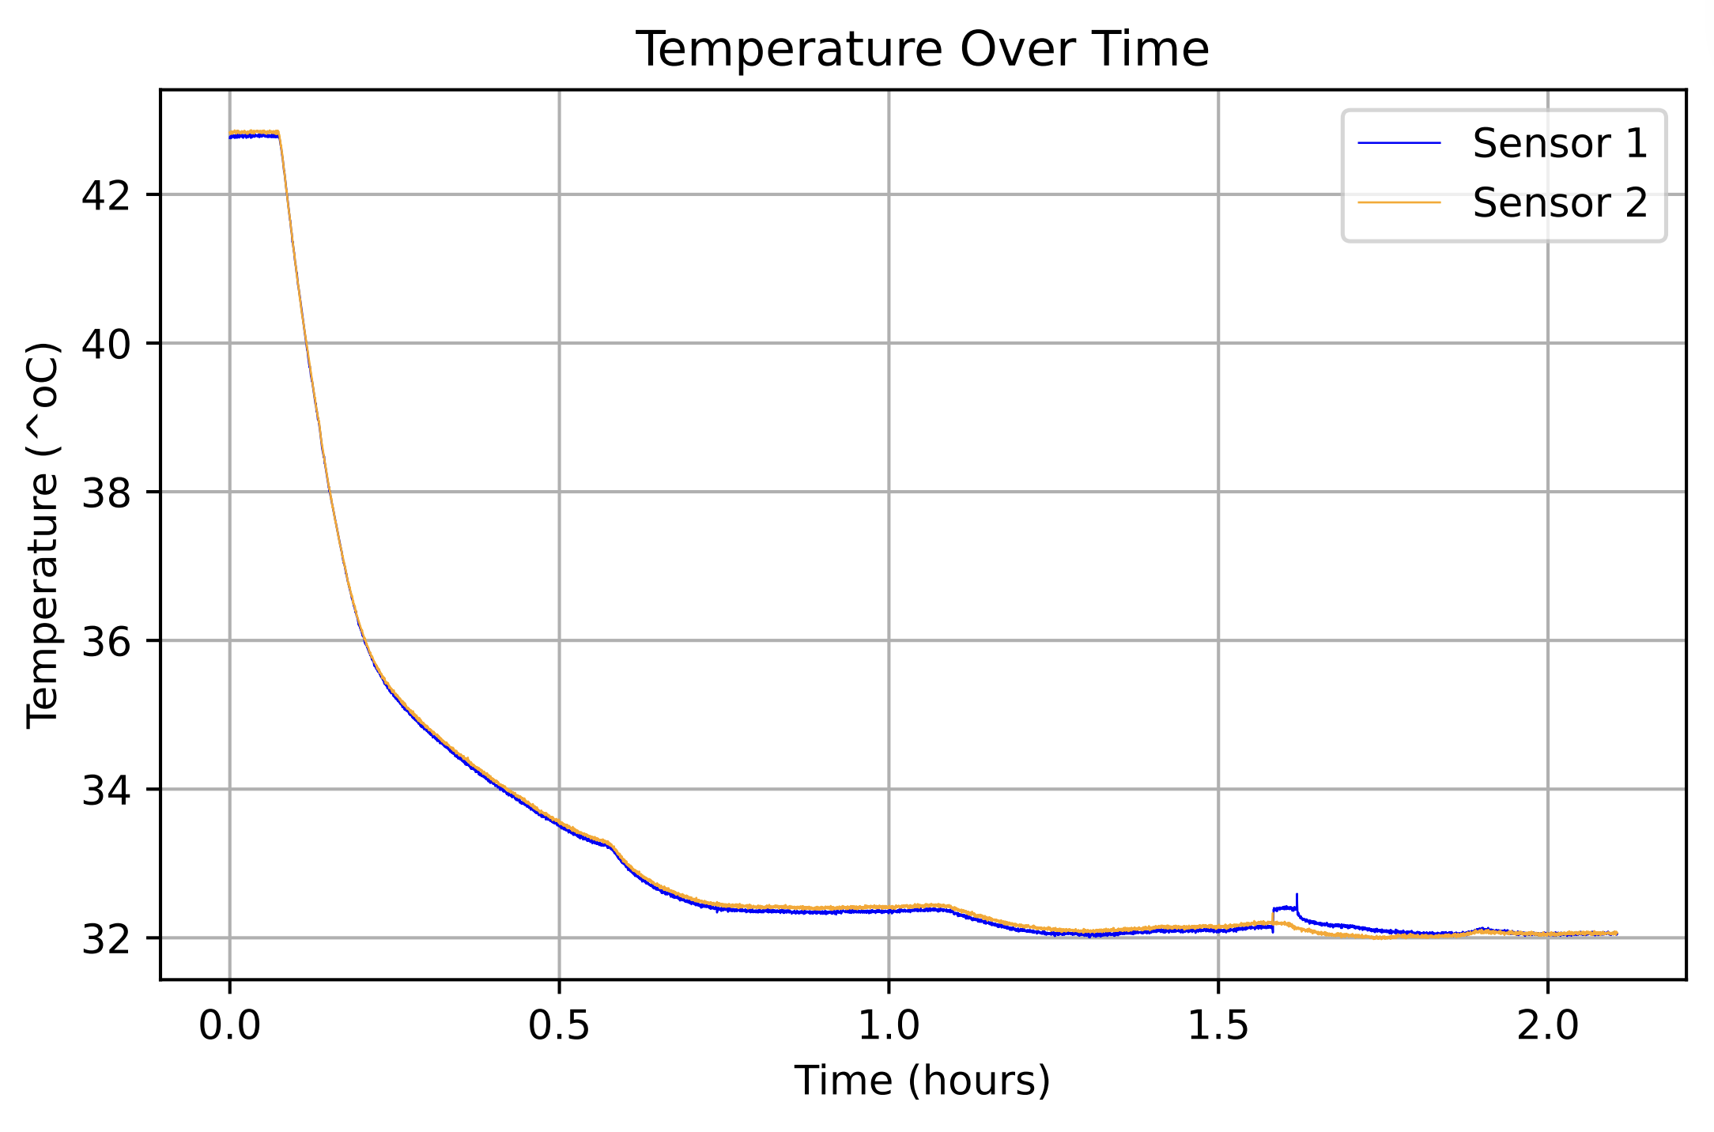
Test #1: Additional close up data
0.511 gal/min flow rate
1.022 gal/min flow rate
1.500 gal/min flow rate
2.001 gal/min flow rate
PDF name- PumpHeat_up_6_hours.vo
PDF name- PumpHeat_HeatExchange.flow.vo

Slide 4
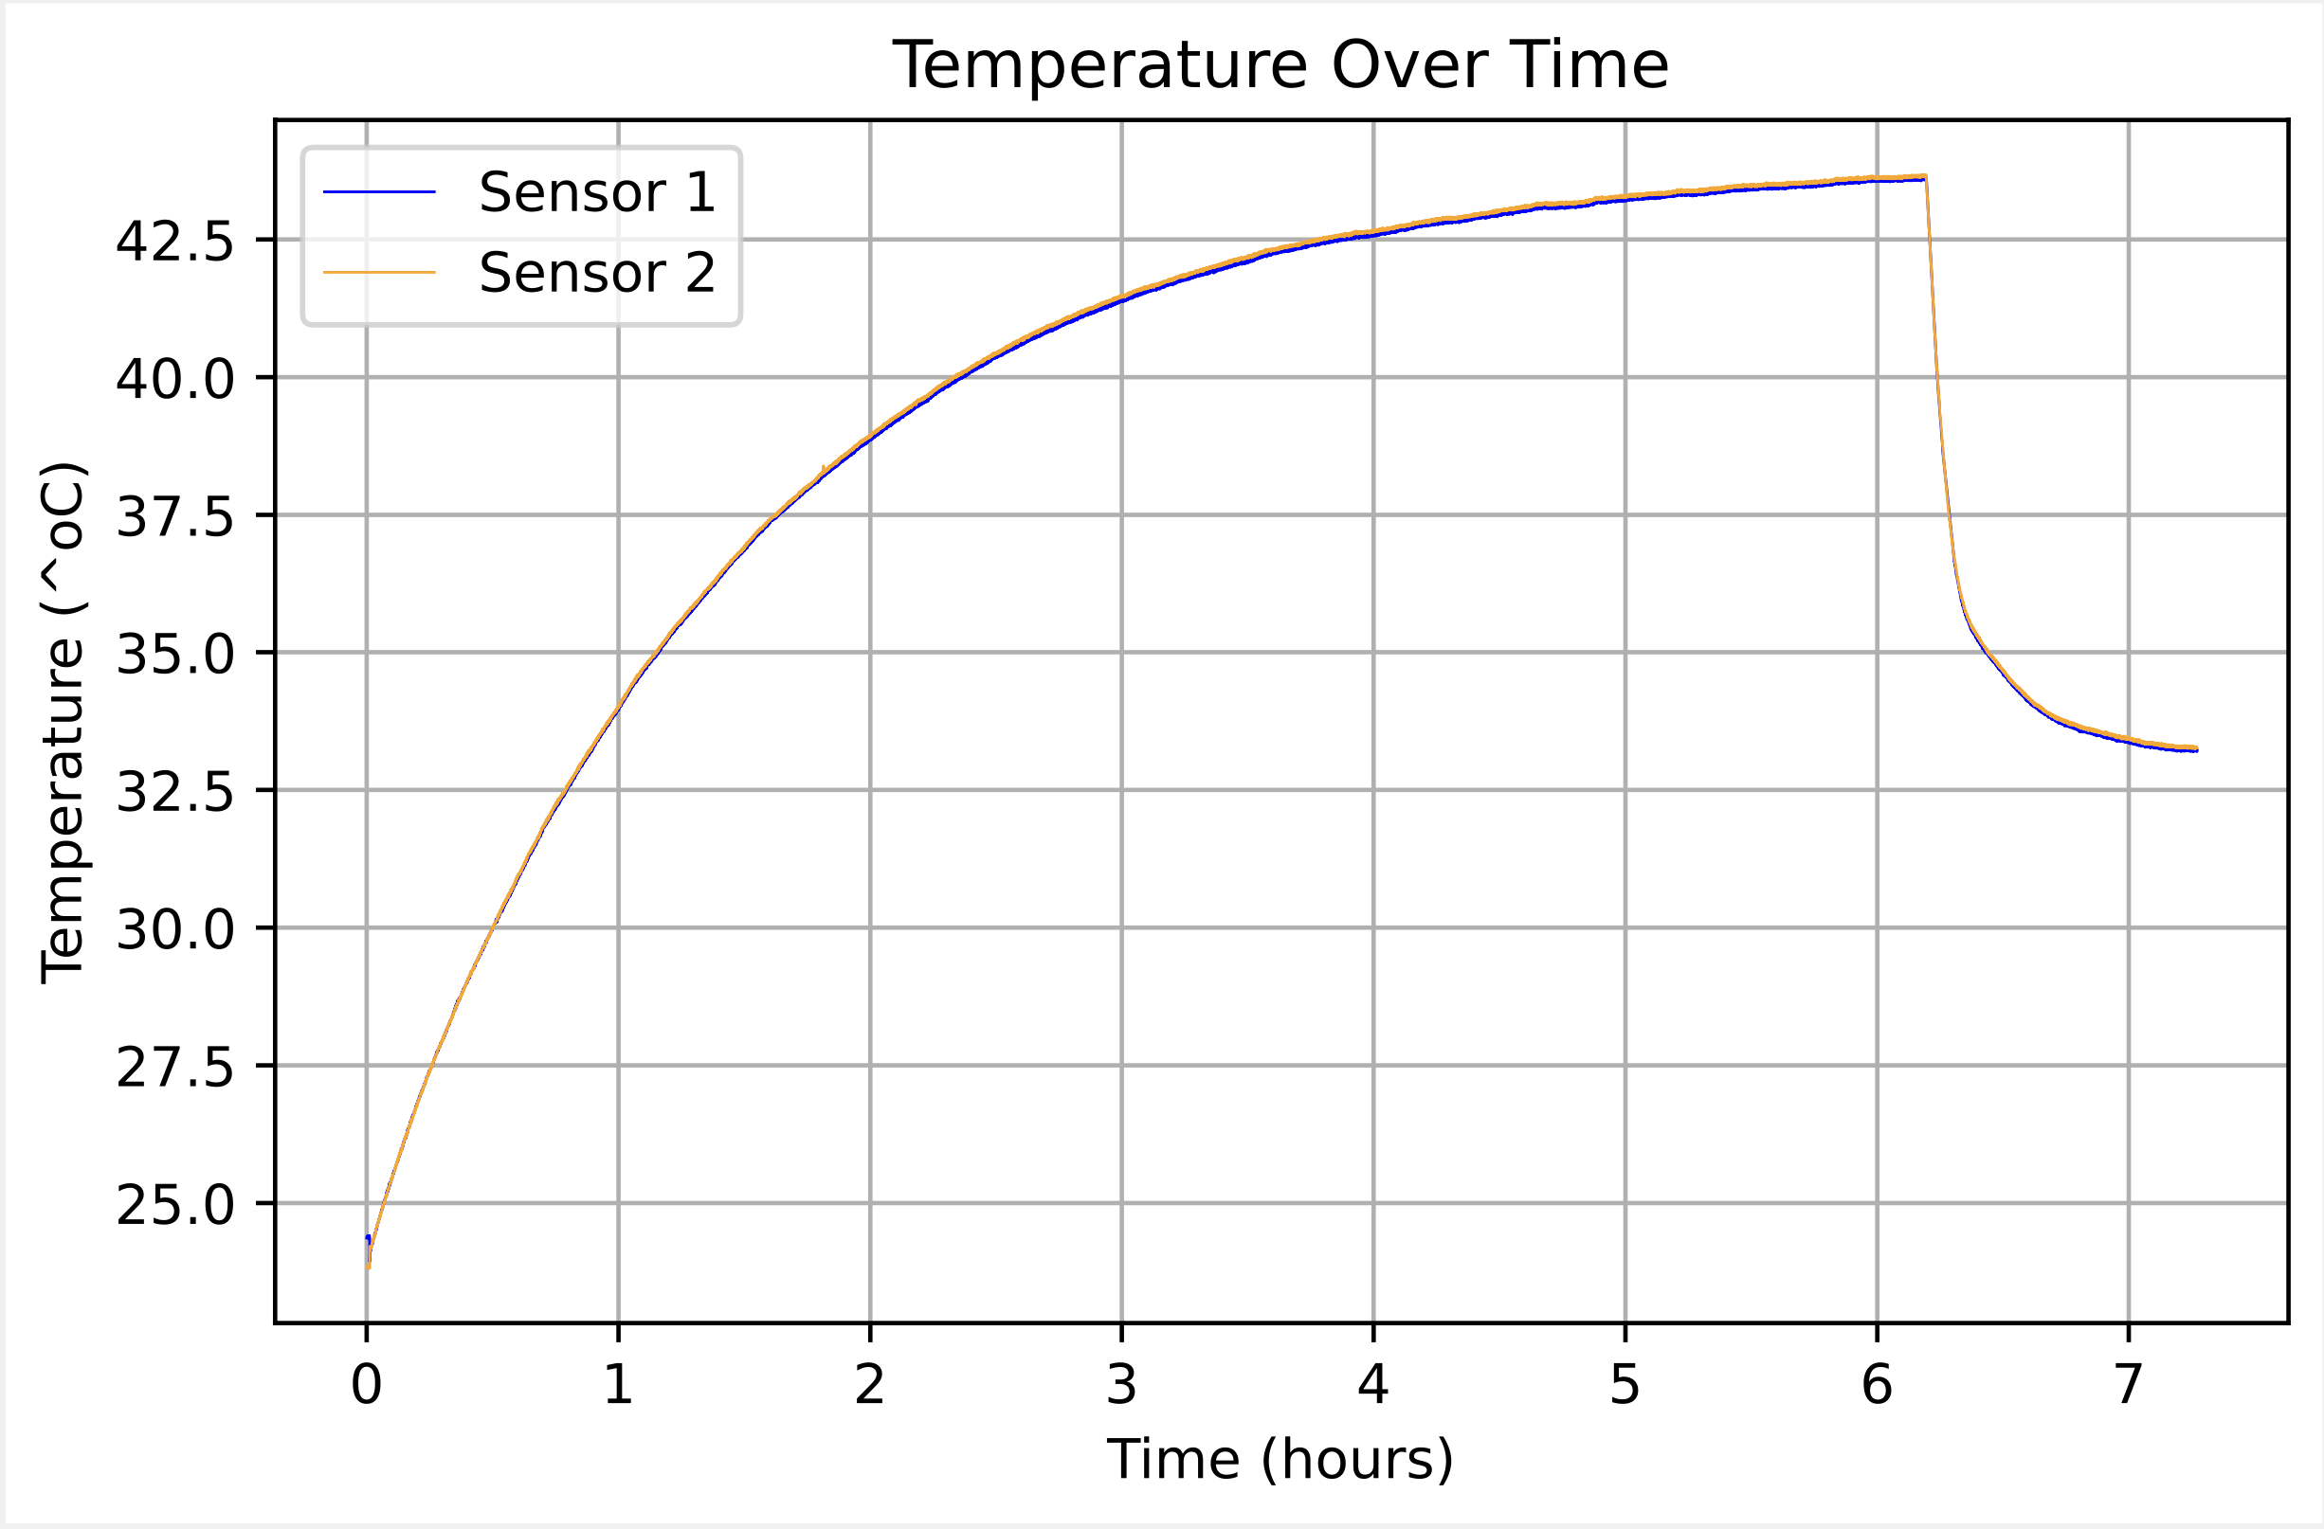
Test #2: Pump Heat up (vc)
Middle valve closed
Upper valve open
Heat exchanger 0.5 gal/min flow rate at 6 hours
Raw Data File name PumpHeat_HeatExchanger.0.5flow.vc
PDF name- Full_PumpHeat(HeatExchange.0.5flow.vc)

Slide 5
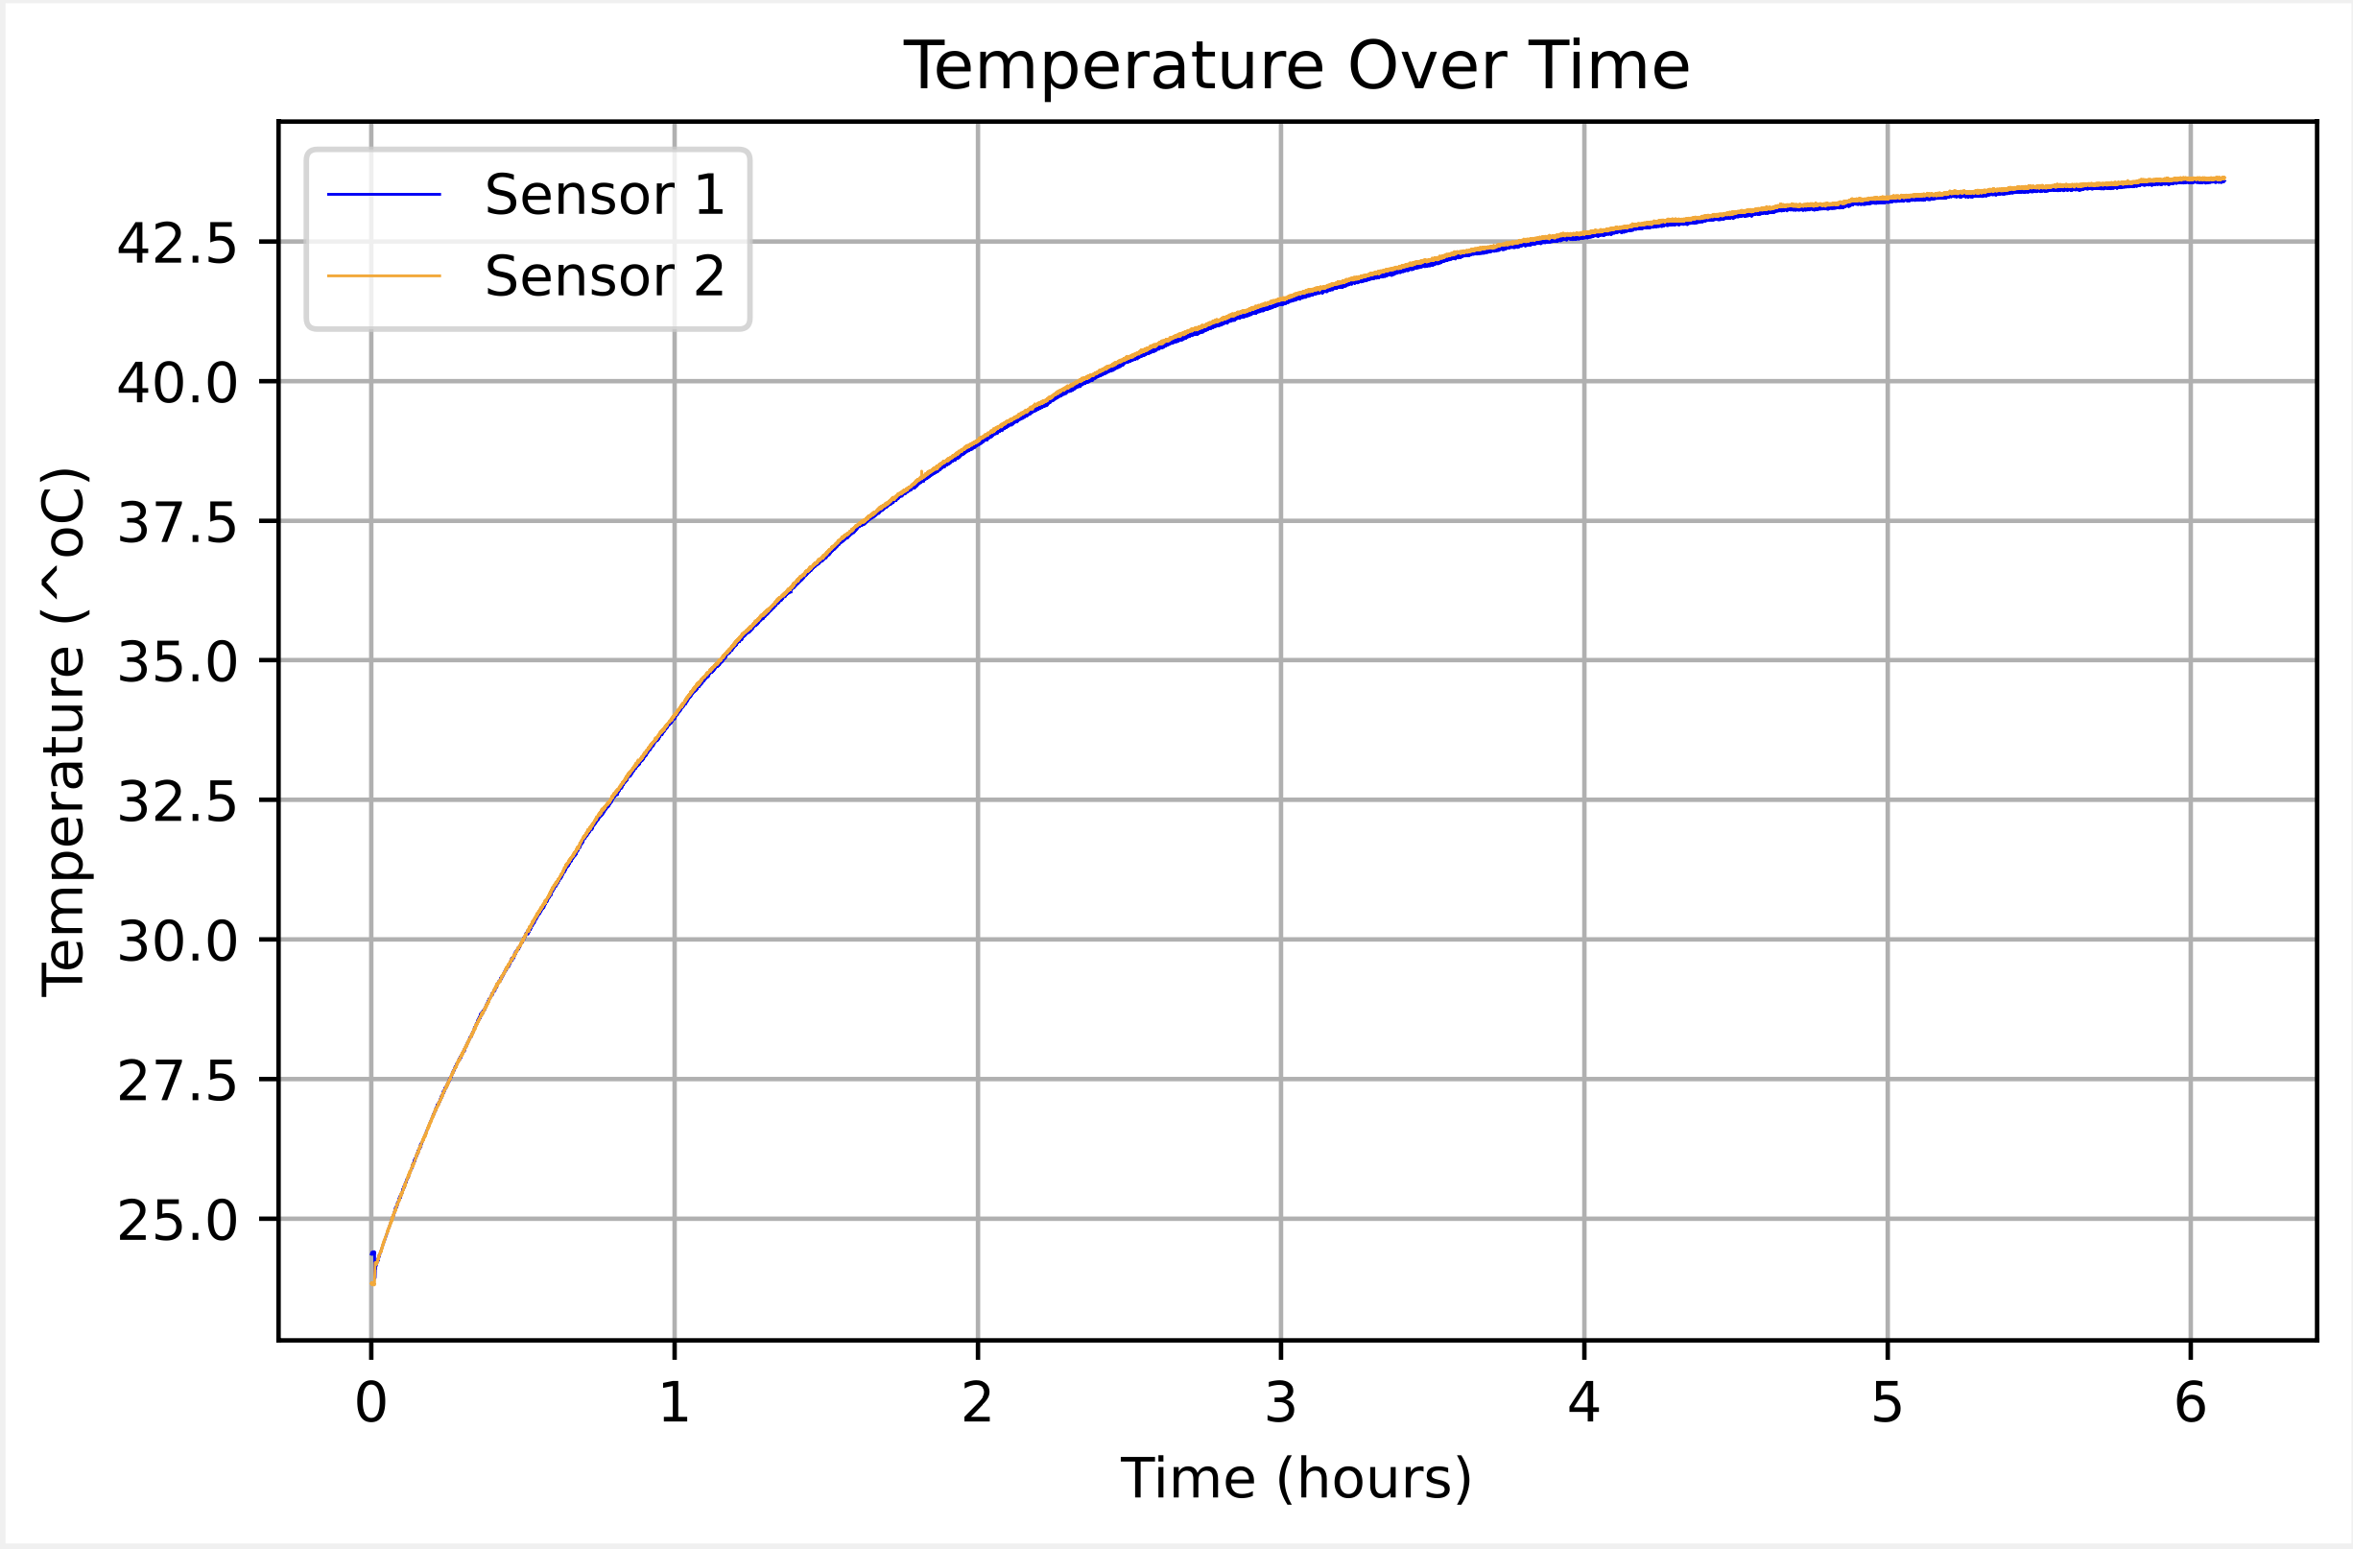
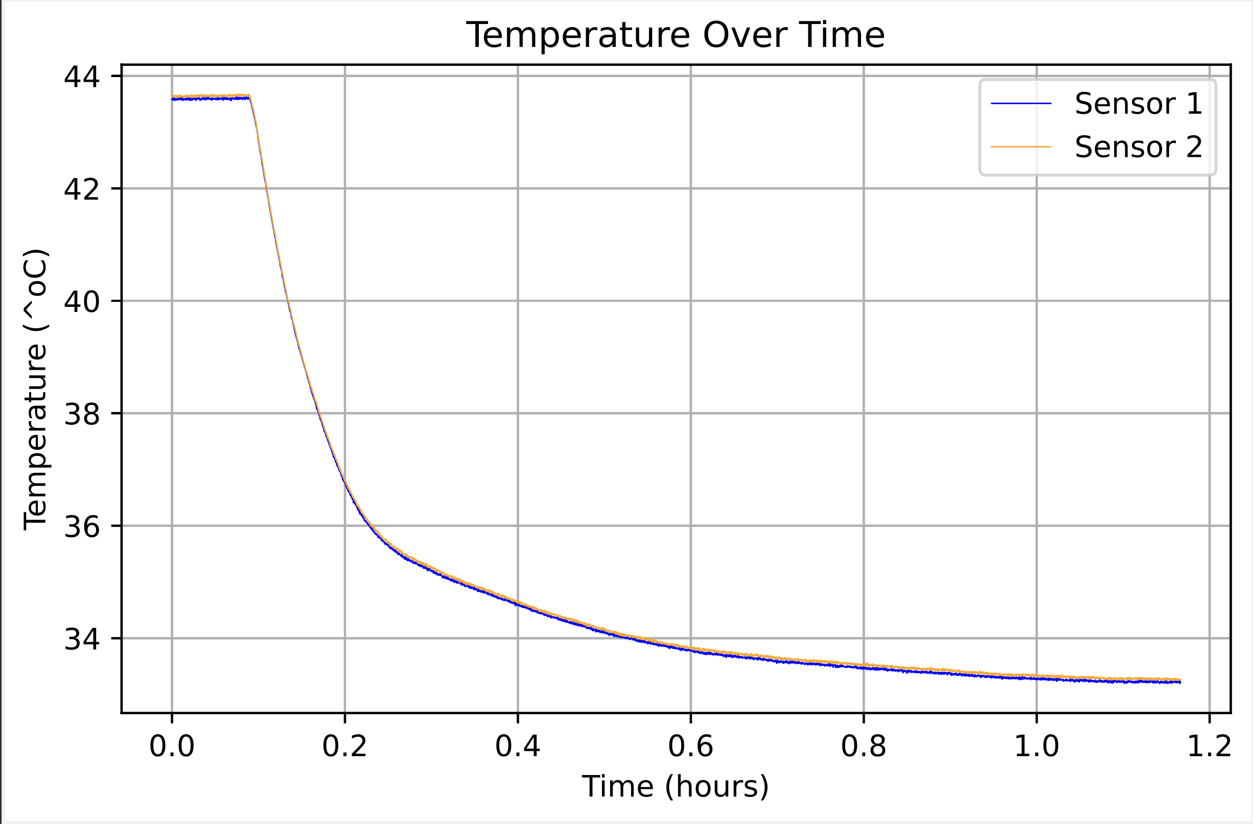
Test #2: Additional close up data
0.511 gal/min flow rate
PDF name- PumpHeat_up_6_hours.vc
PDF name- PumpHeat_HeatExchange_0.5gal._flow.vc

Slide 6
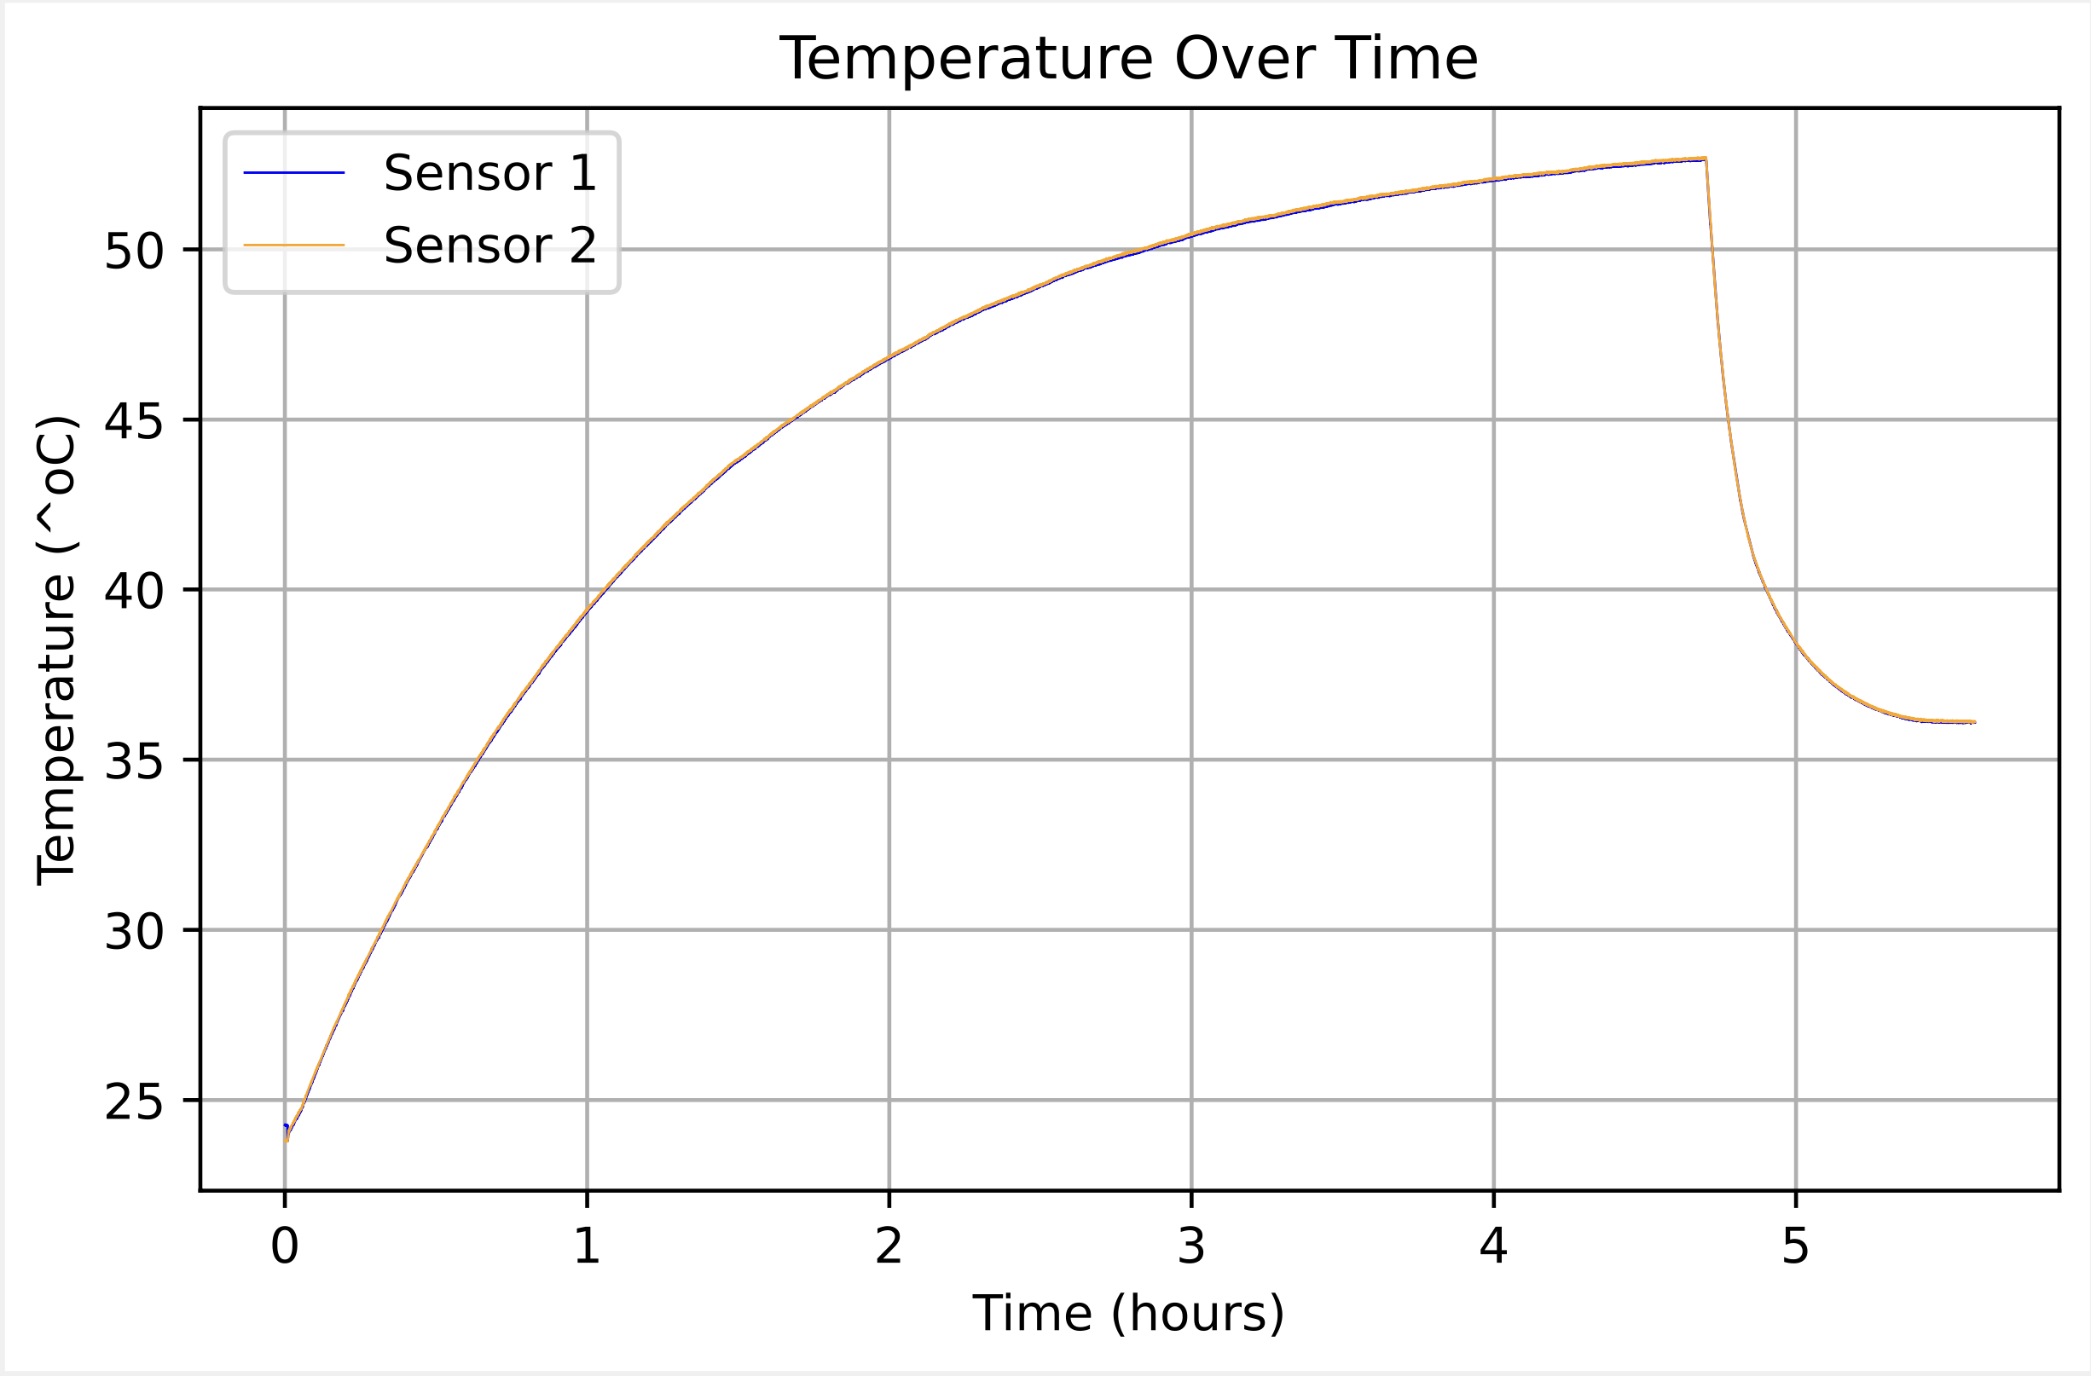
Test #3: Rod Heat up (vc)
Middle Valve closed
Upper Valve open
Heat Exchanger 0.5 gal/min at 4.5 hours
Raw Data File name
RodHeat_NewData
PDF name- Full_RodHeat(HeatExchange.flow.vc)

Slide 7
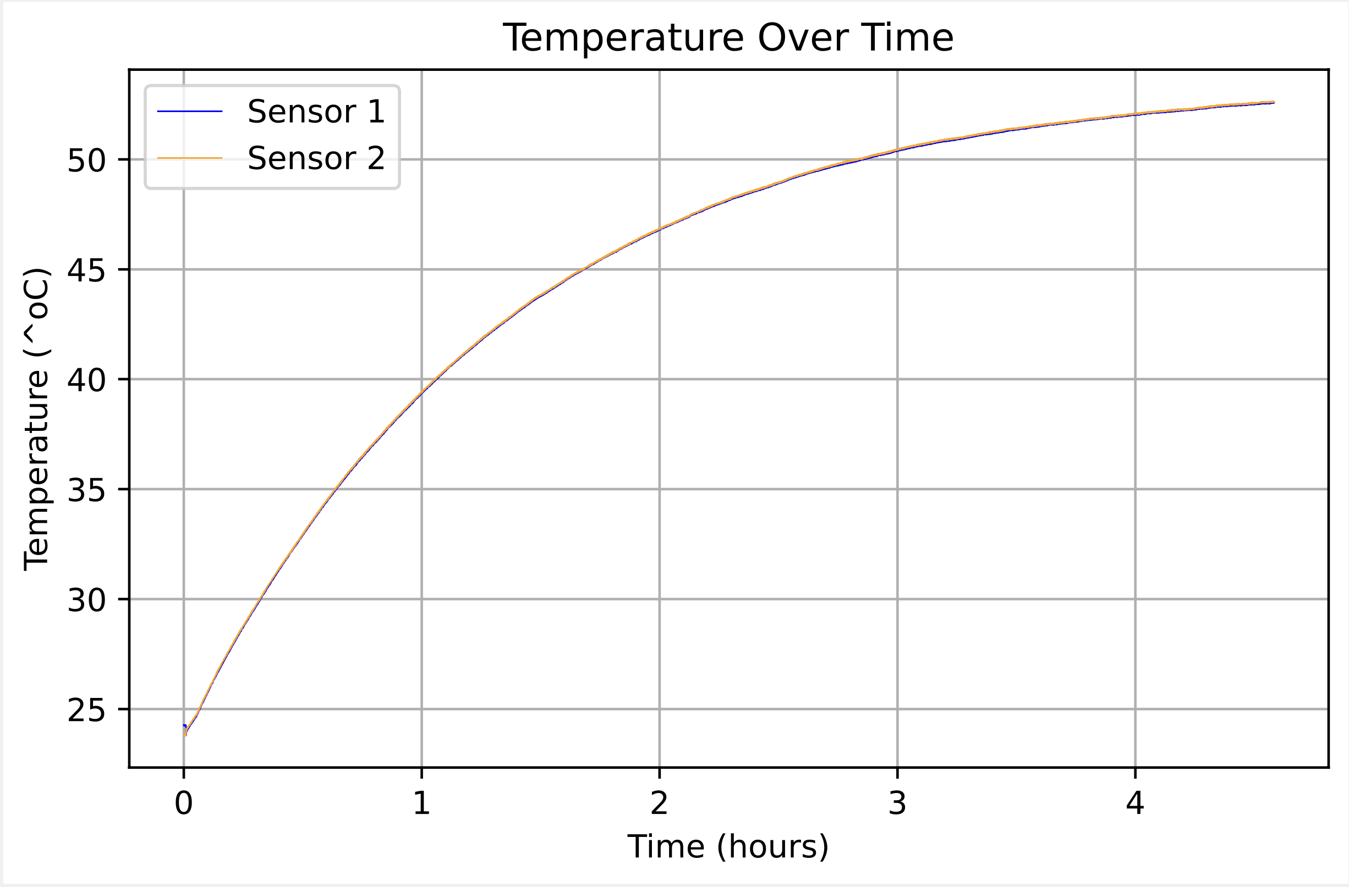
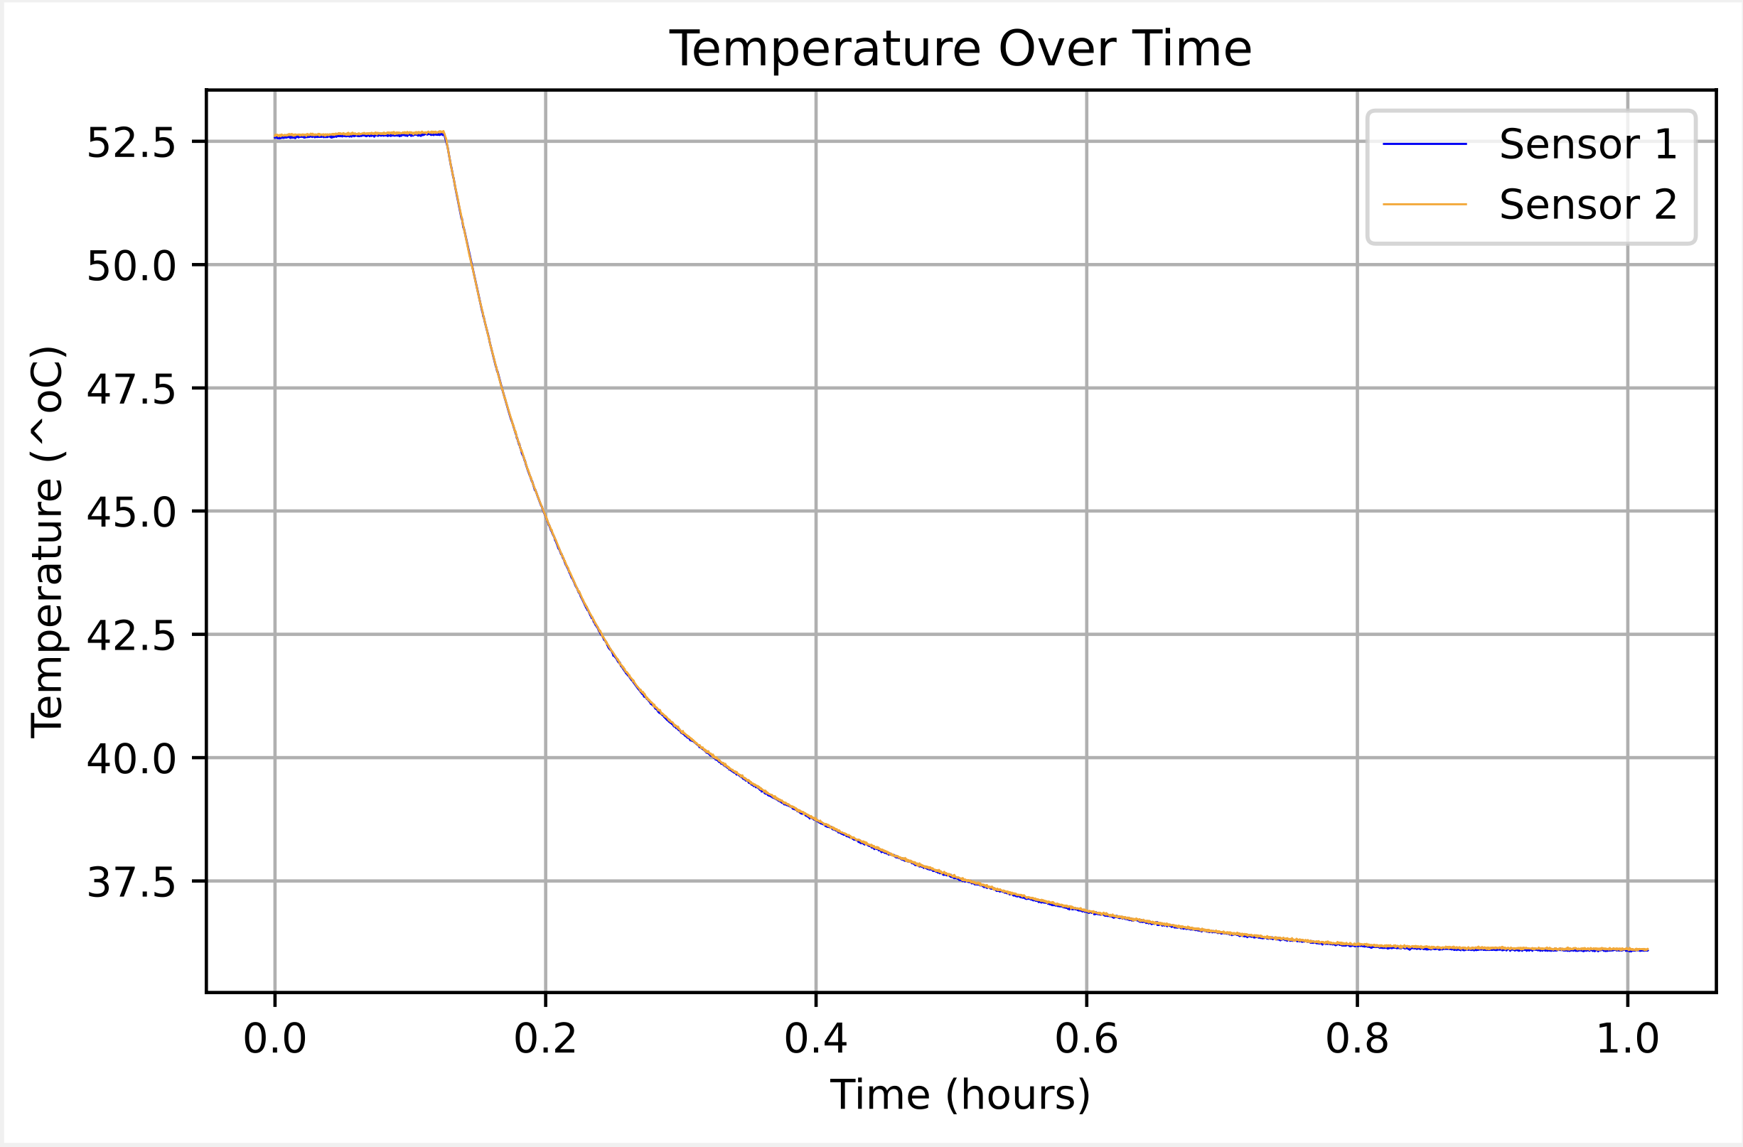
Test #3: Additional close up data
0.511 gal/min flow rate
PDF name- RodHeat_6_hours.vc
PDF name- RodHeat_0.5_gal_flow.vc

Slide 8
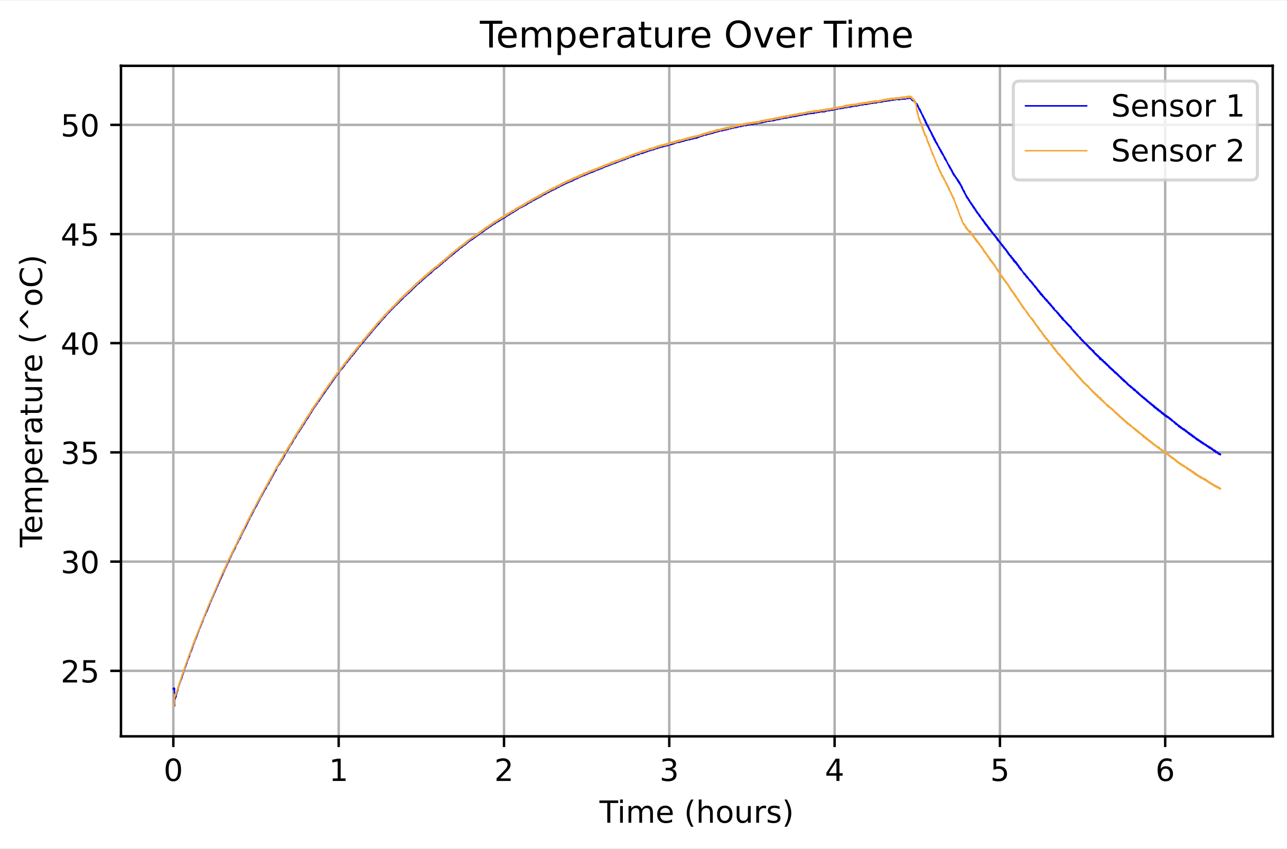
Test #4: Rod Heat up (vo)
Middle Valve open
Upper Valve open
At 4.45 hours Pump and Rod turned off
Raw Data File name
RodHeat_vo_cool_NewData
PDF name- Full_RodHeat.vo(CoolDown)

Slide 9
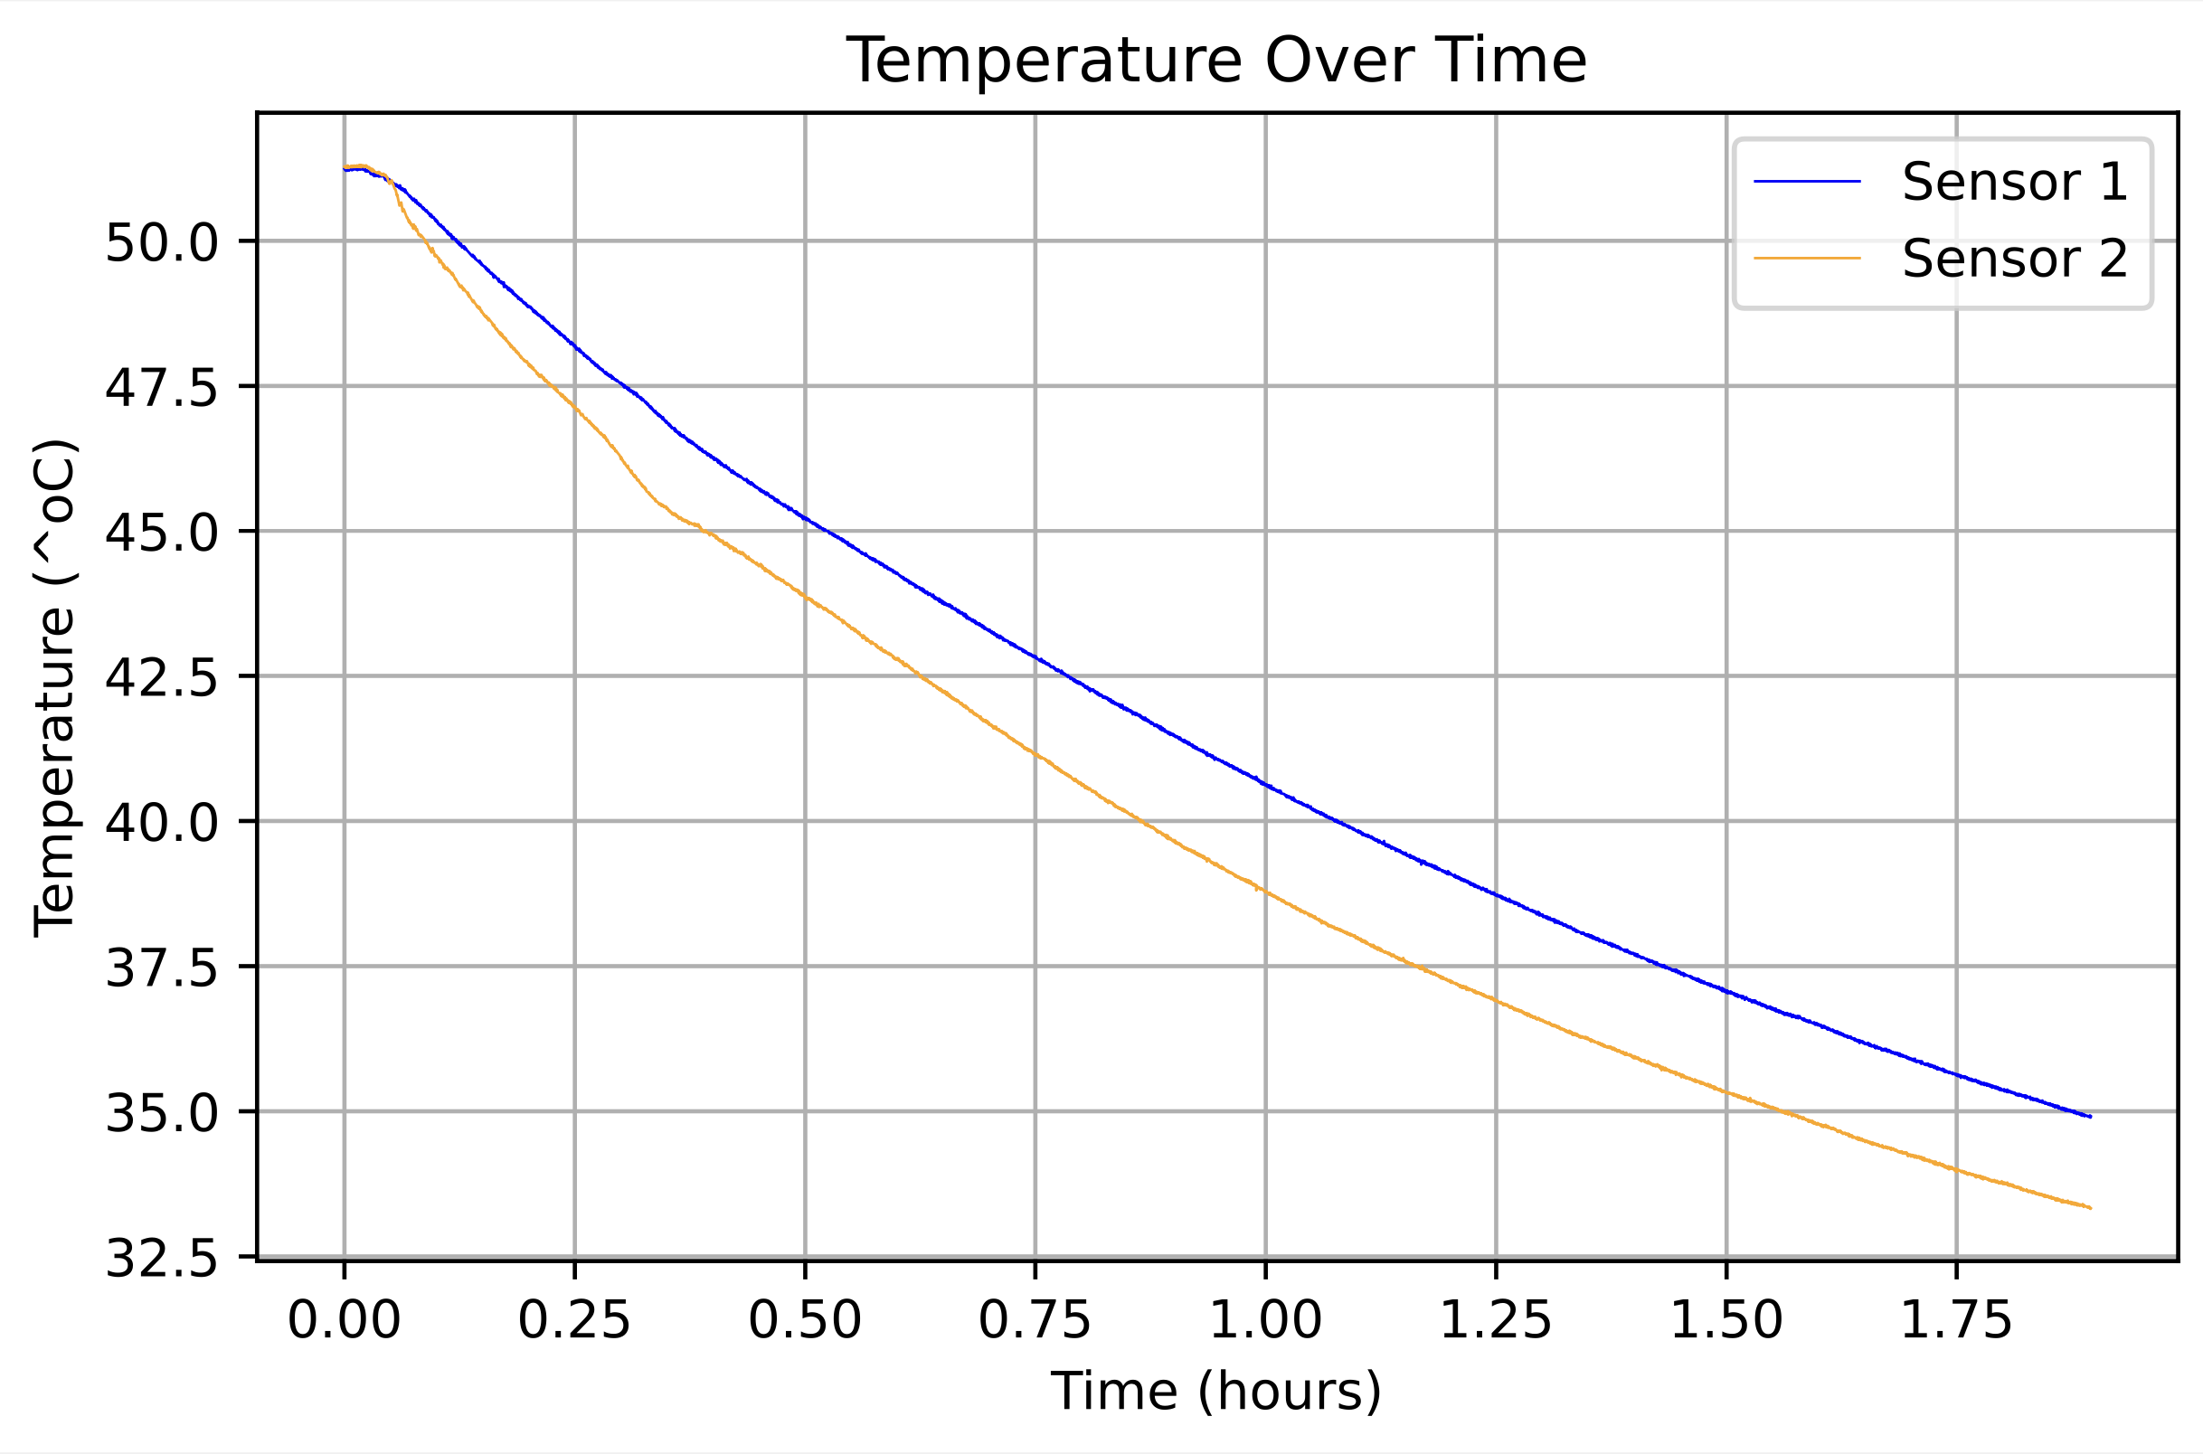
Test #4: Additional close up data
Pump and Rod turned off
PDF name- RodHeat_up.vo
PDF name- RodHeat_CoolDown.vo

